Slide 1
📌 PROJECT 4 📌
📱Mobile Price Prediction📱
SIDDIQUI SABA
🏢 Next Hikes IT Solutions

Slide 2
🚀 Introduction 🚀
📱 📱 📱 📱 📱 📱 📱 📱 📱 📱 📱 📱 📱 📱 📱 📱 📱
With the smartphone market evolving rapidly, predicting prices has
become a fascinating challenge. This project leverages machine learning to transform raw mobile specs into precise price predictions, making technology smarter and decision- making easier.

Slide 3
📱 Project Overview 📱
📌 Objective: Predict mobile prices accurately based on features like RAM, Battery, Camera, etc.
📌 Tools Used: Python, Pandas, Matplotlib, Seaborn, Scikit-learn
📌 Methods: Data preprocessing, visualization, model training & evaluation

Slide 4
📱Project Workflow 📱
📌 Data Collection
📌 Data Cleaning & Preprocessing
📌 Exploratory Data Analysis (EDA)
📌 Feature Engineering
📌 Model Training
📌 Model Evaluation
📌 Predictions

Slide 5
🔍Challenges & Solutions🔍
📌 Challenges Faced:
📌 Handling missing values
📌 Selecting relevant features
📌 Avoiding model overfitting
📌 📌 Solutions:
📌 Used fillna() and imputation techniques
📌 Applied feature selection and encoding
📌 Used cross-validation to improve generalization

Slide 6
📱 Results 📱
📌 MAE: 0.0
📌 MSE: 0.0
📌 RMSE: 0.0
📌 R²: 1.0
📌 The model achieved perfect accuracy on the given dataset.

Slide 7
CONCLUSION & THANKS 💡
📌 This project demonstrated how machine learning can be applied to predict mobile prices effectively.
📌 With proper preprocessing, feature engineering, and evaluation, high accuracy can be achieved.
📌 Special thanks to Jupyter Notebook for providing an interactive coding environment.

Slide 8
📝 References 📝
📌 Python Official Documentation
📌 Pandas & Scikit-lear DOCUMENTATION
📌 Matplotlib & Seaborn Libraries
📌 Kaggle Datasets

Slide 9
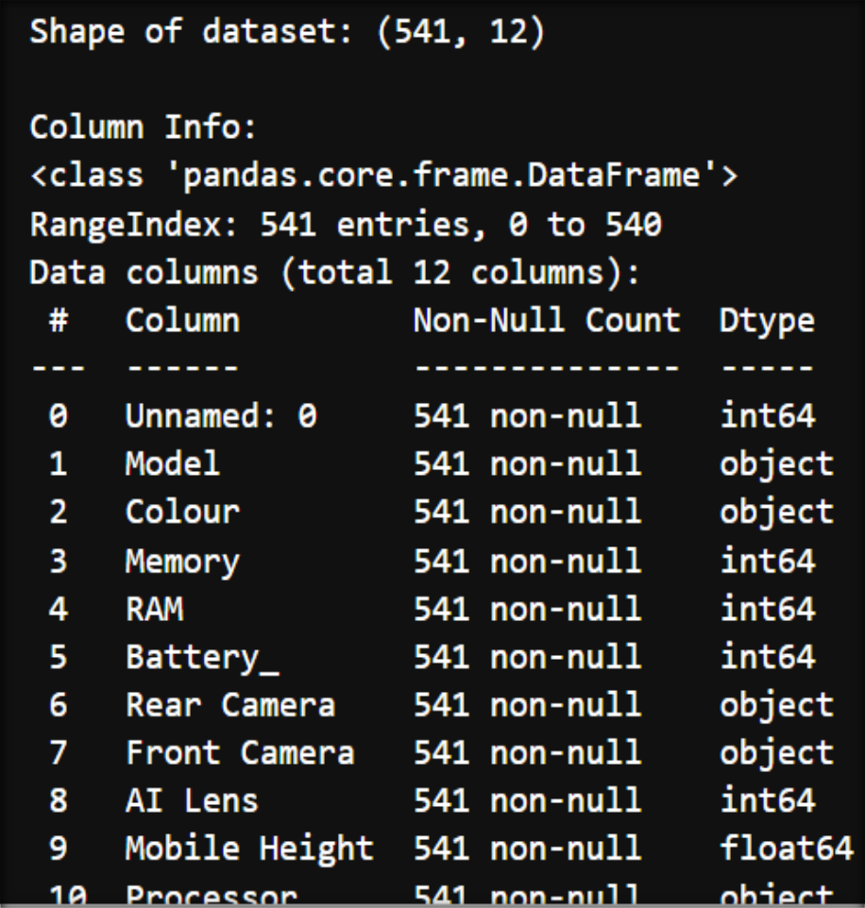
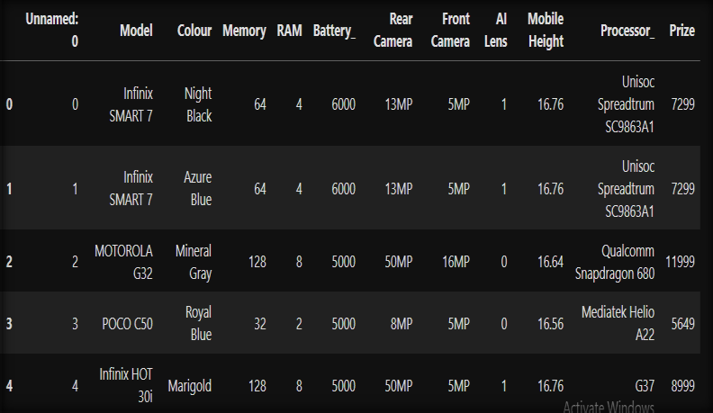
📸 SCREEN SHOT :1 📸
🚀 Explore the Data 🚀

Slide 10
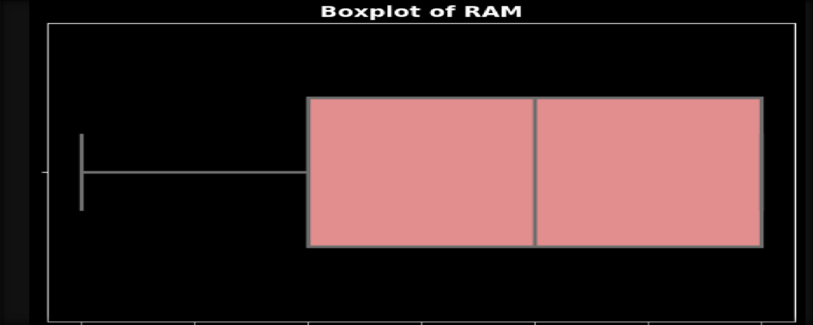
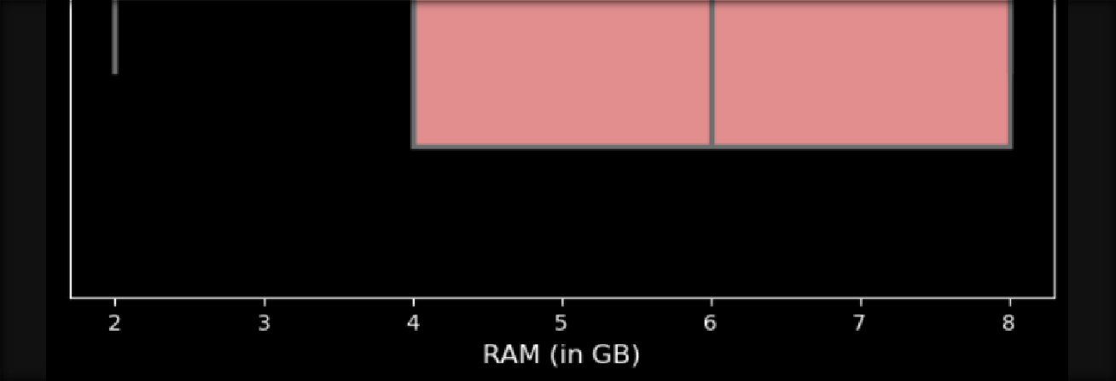
📸 SCREEN SHOT : 2 📸
📦 Boxplot for RAM 📦

Slide 11
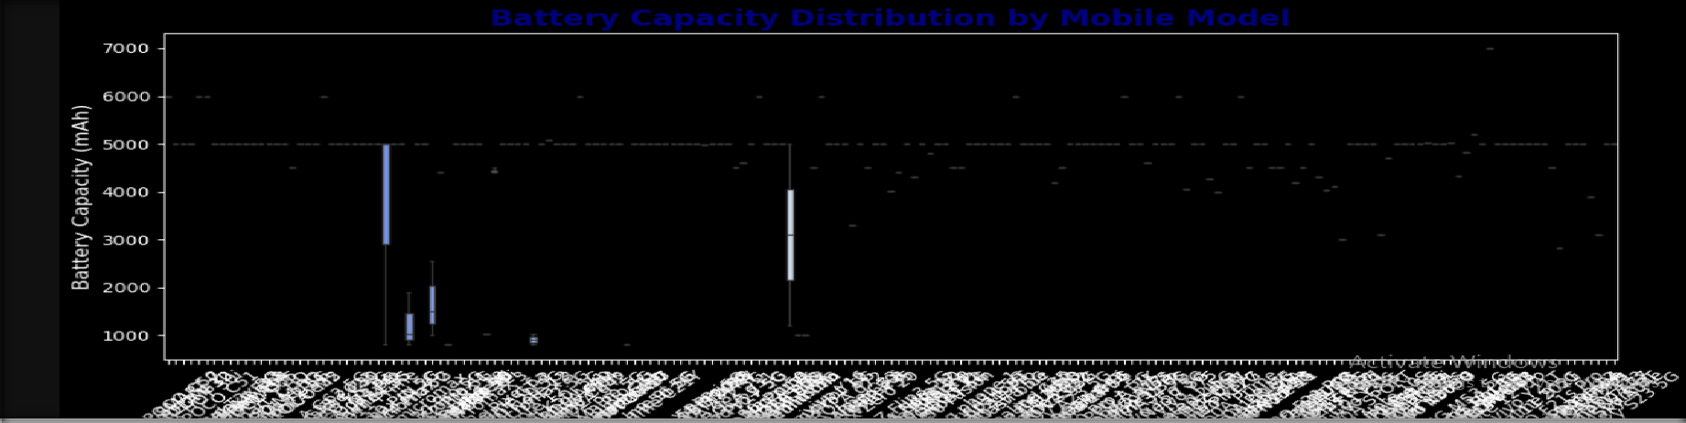
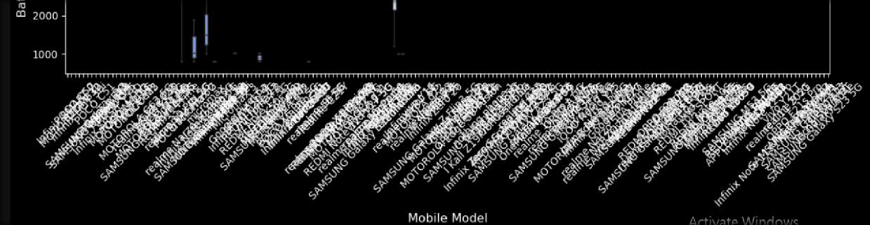
📸 SCREEN SHOT :3 📸
🔋 Boxplot for Battery

Slide 12
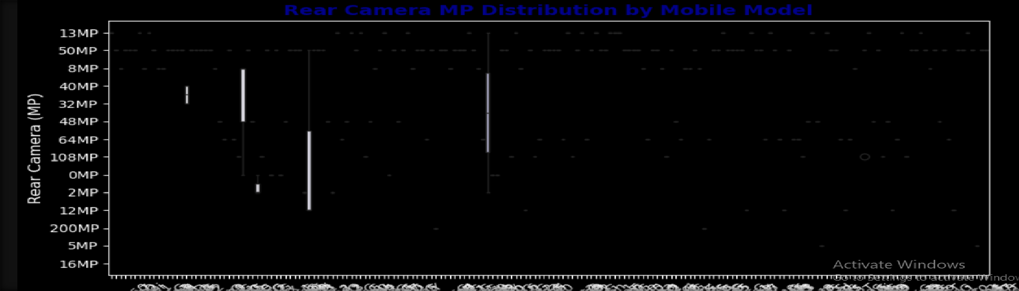
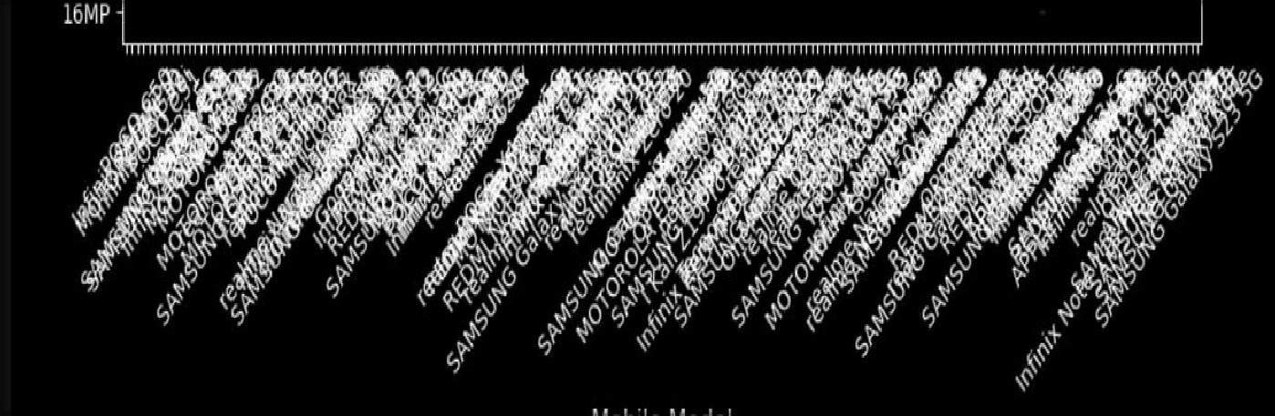
📸 SCREEN SHOT: 4 📸
✅ 1. Rear Camera Boxplot

Slide 13
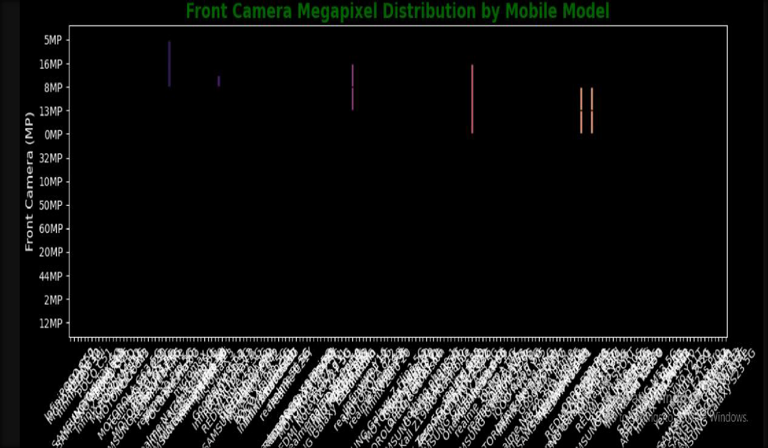
📸 SCREEN SHOT : 5 📸
✅ Front Camera Boxplot

Slide 14
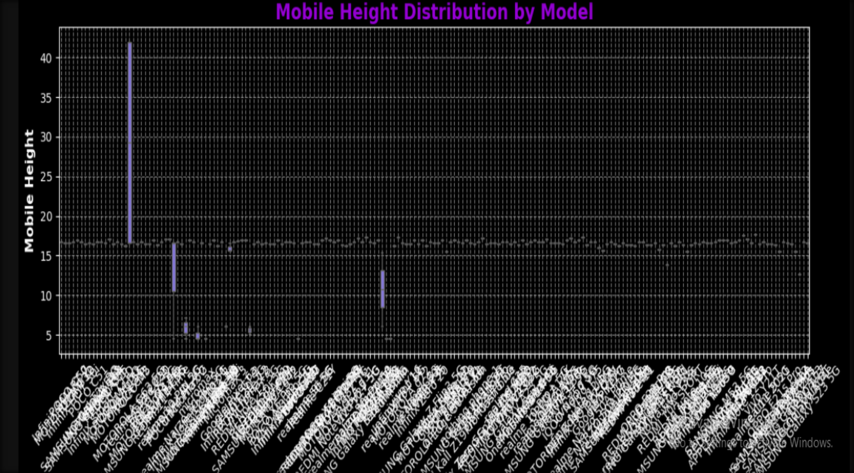
📸 SCREEN SHOT : 6 📸
✅ Boxplot for Mobile Height

Slide 15
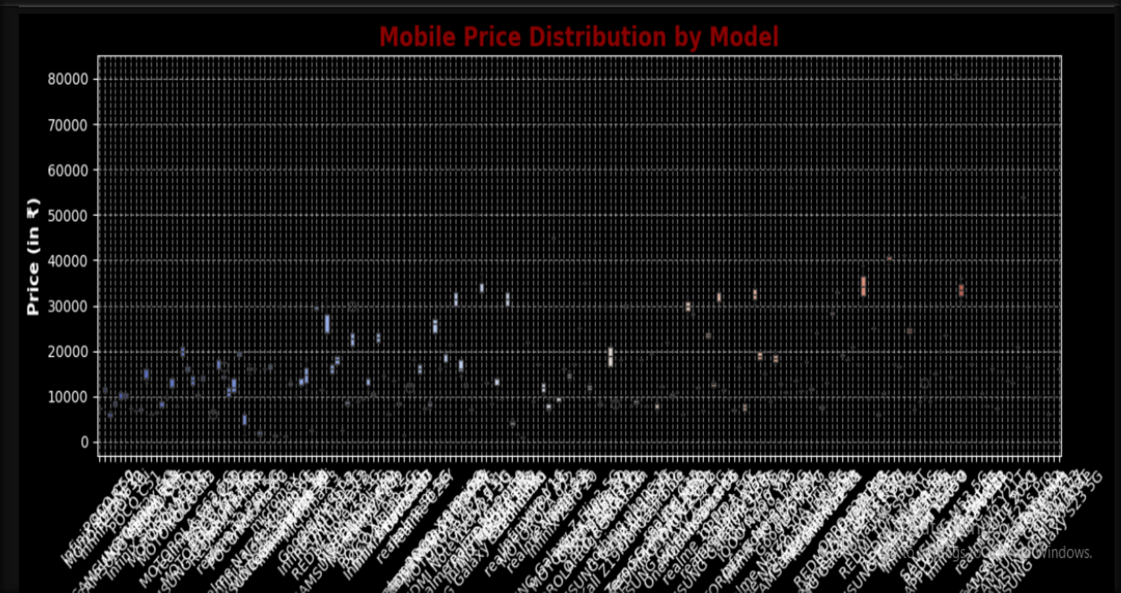
📸 SCREEN SHOT : 7 📸
📊 Boxplot for Mobile Price by Model.

Slide 16
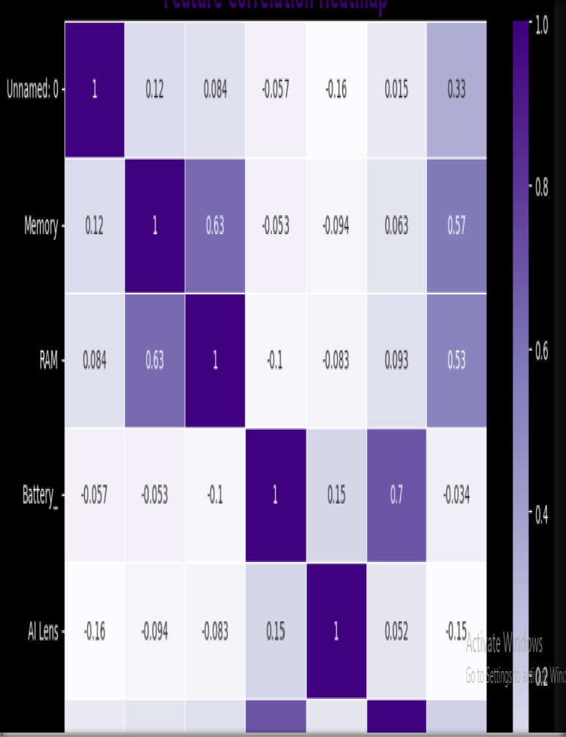
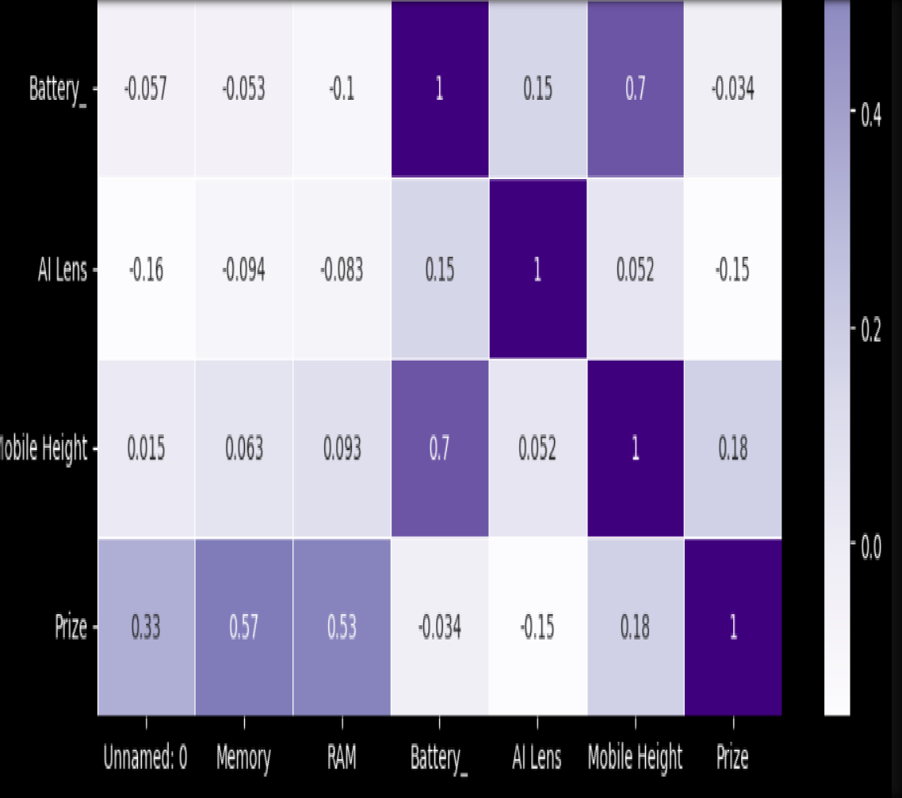
📸 SCREEN SHOT : 8 📸
🔍 Correlation Heatmap 🔍

Slide 17
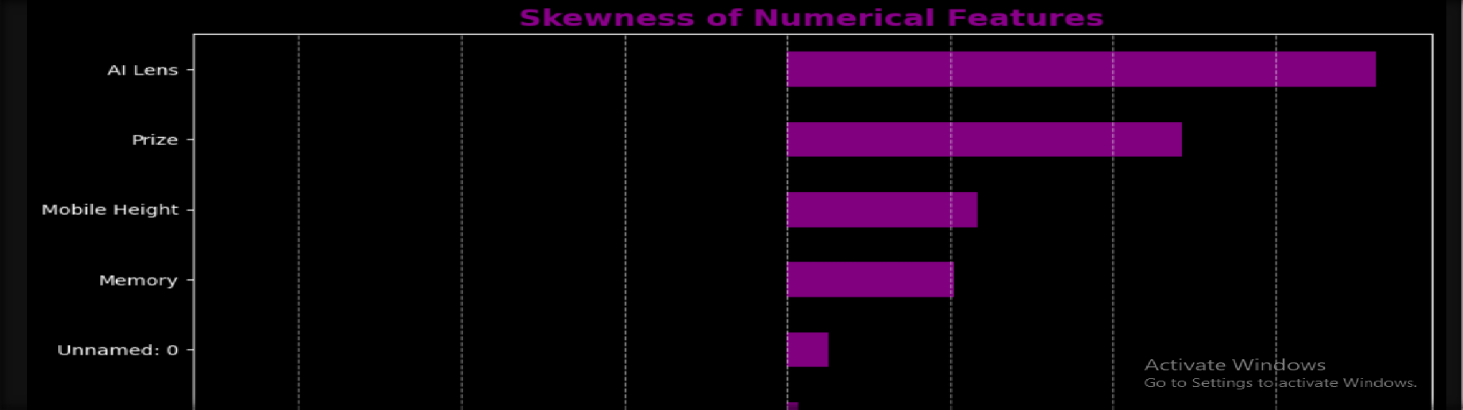
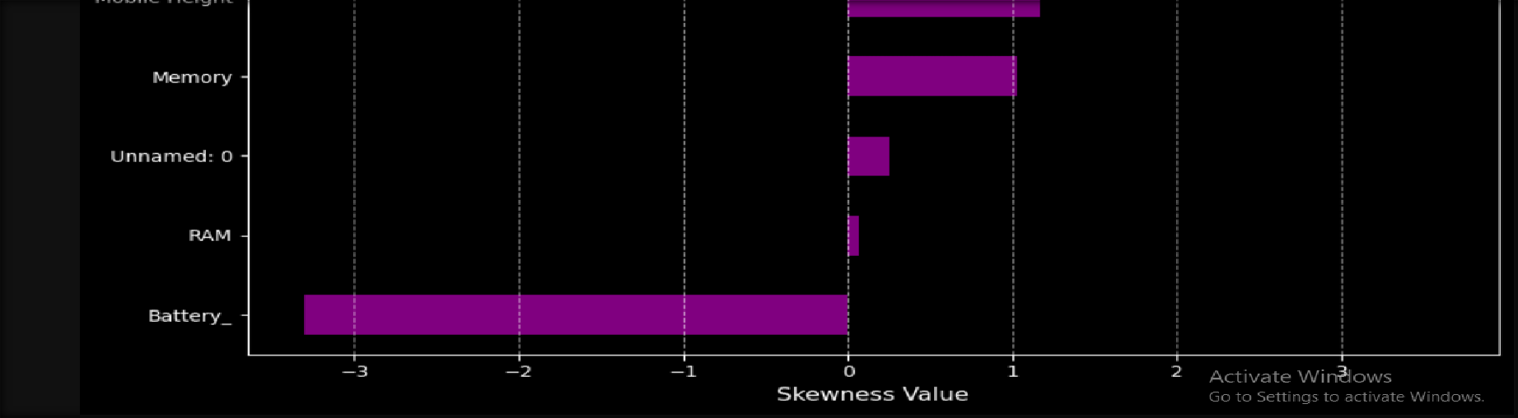
📸 SCREEN SHOT : 9 📸
📌 Skewness Analysis 📌

Slide 18
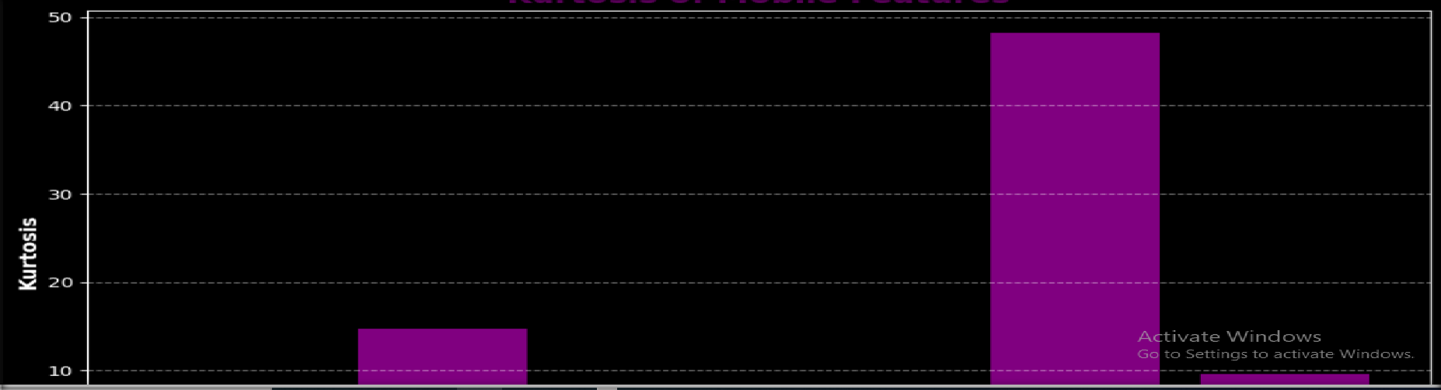
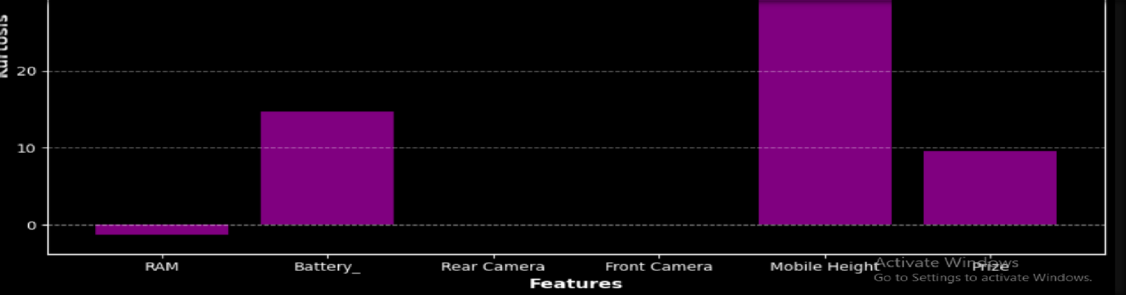
📸SCREEN SHOT : 10 📸
📈 Kurtosis Analysis

Slide 19
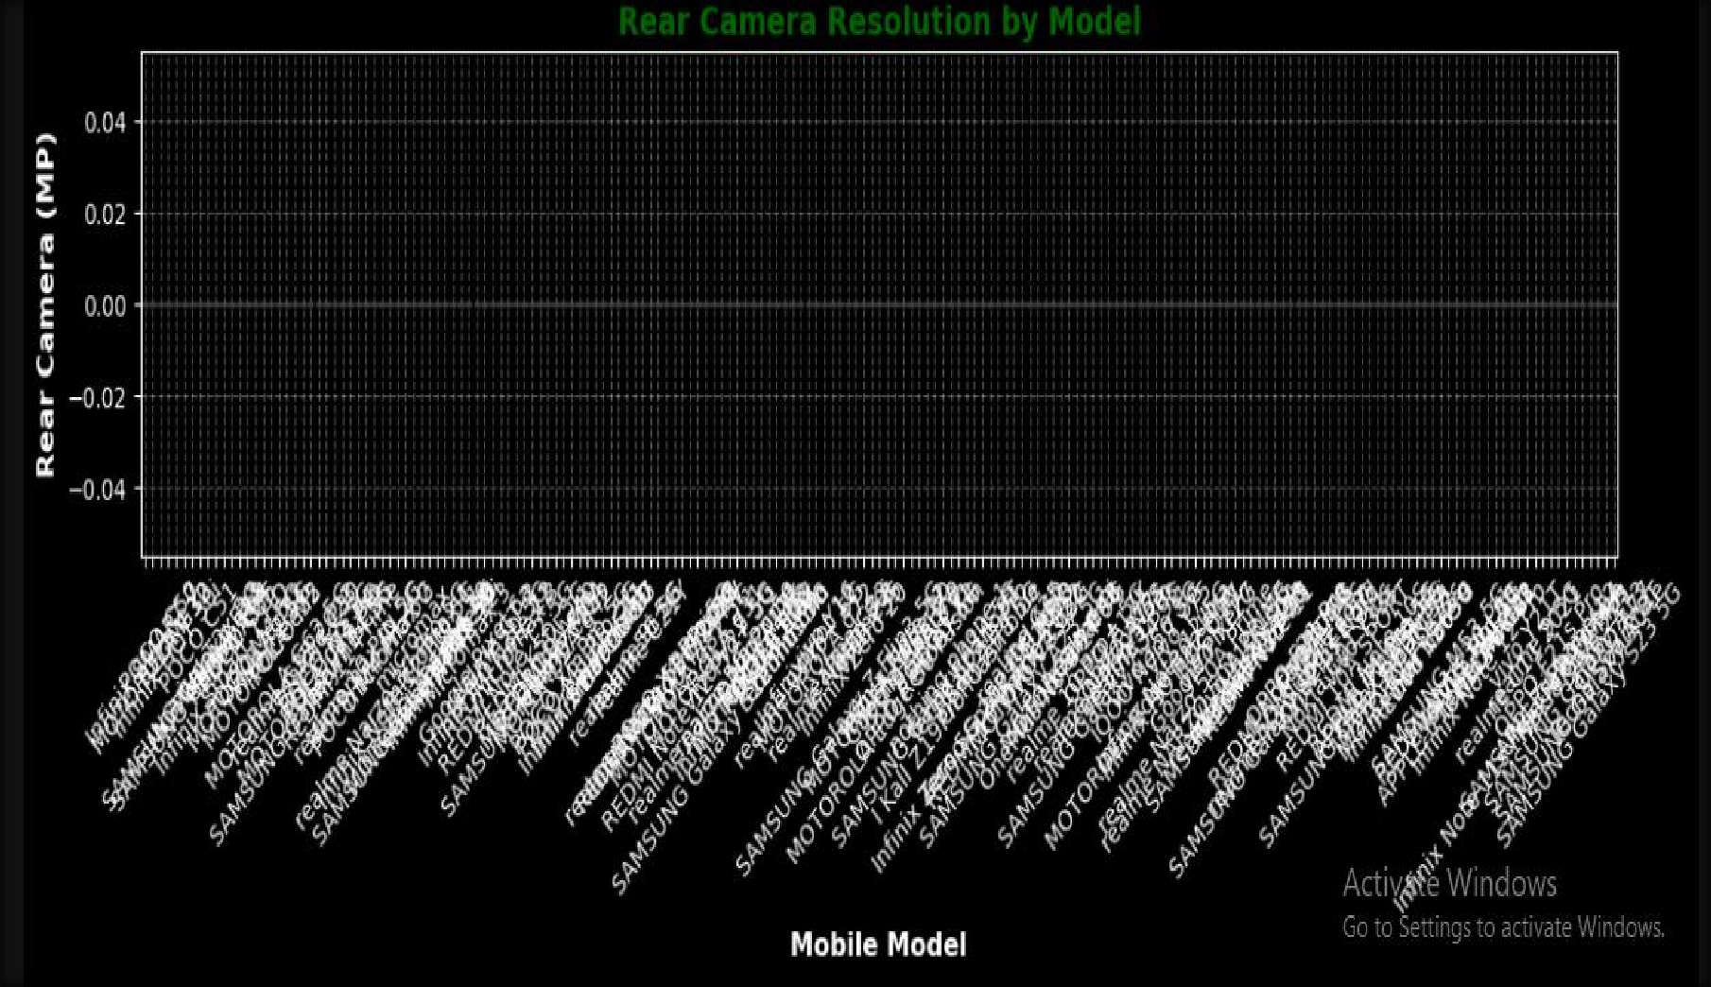
📸 SCREEN SHOT : 11 📸
📊 Boxplot Analysis: Rear Camera Resolution by Mobile Model

Slide 20
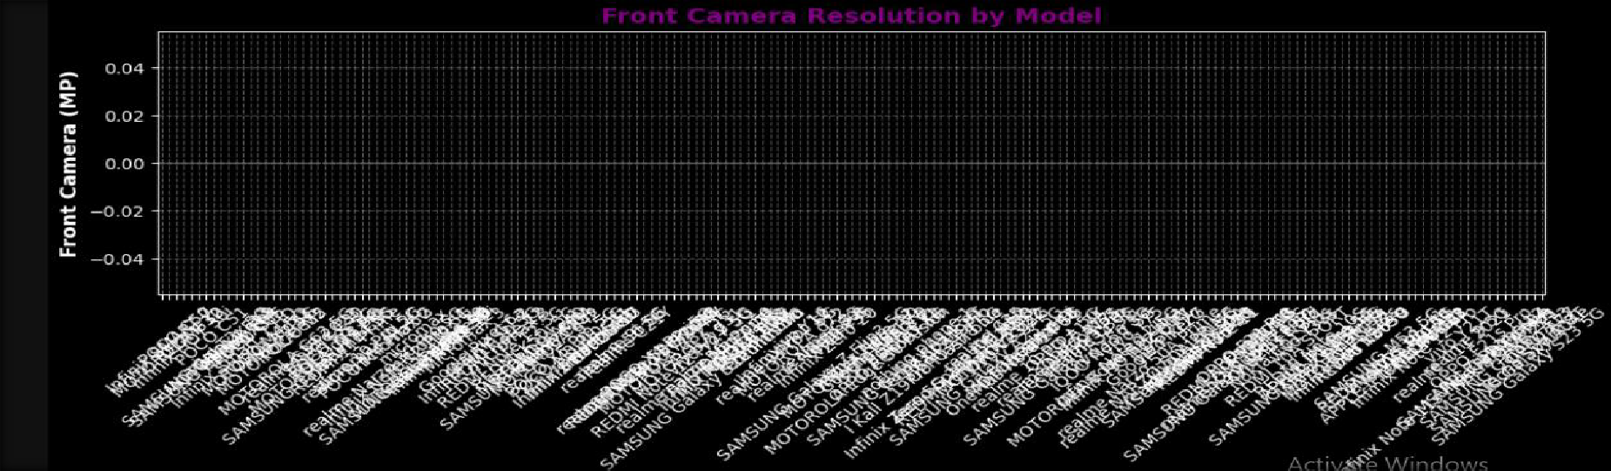
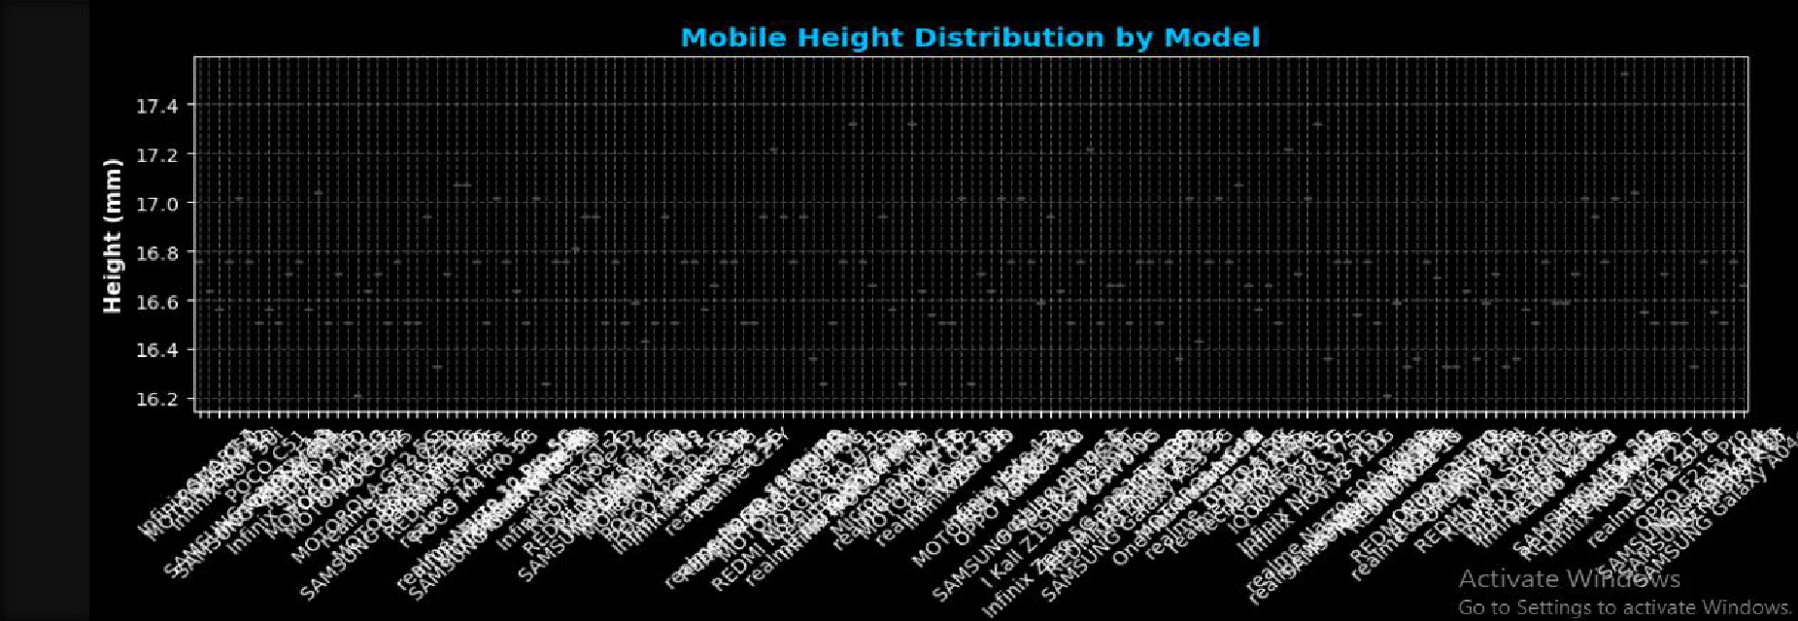

Slide 21
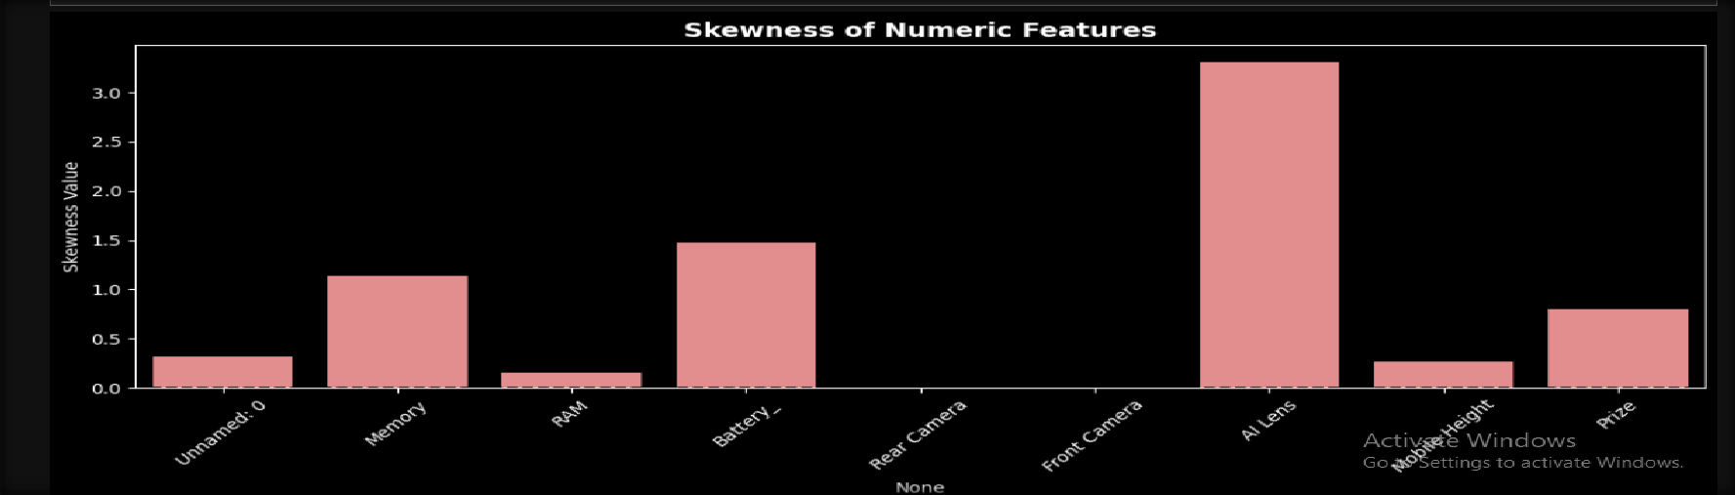
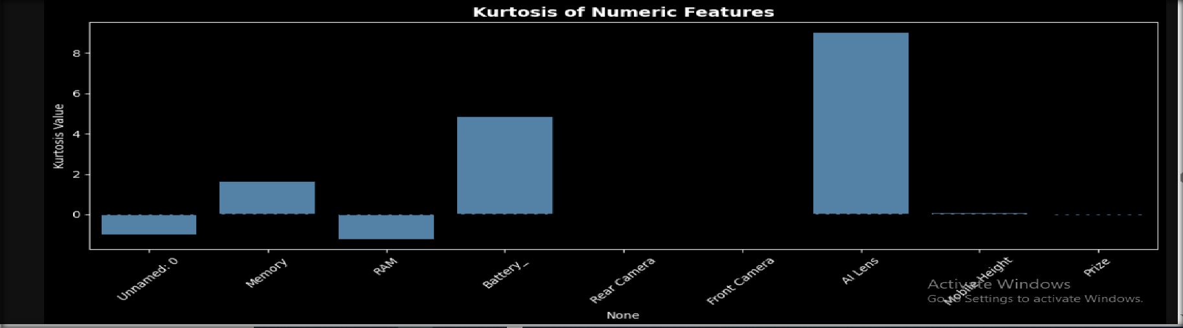
📸 SCREEN SHOT : 12 📸
✅ Skewness & Kurtosis Analysis

Slide 22
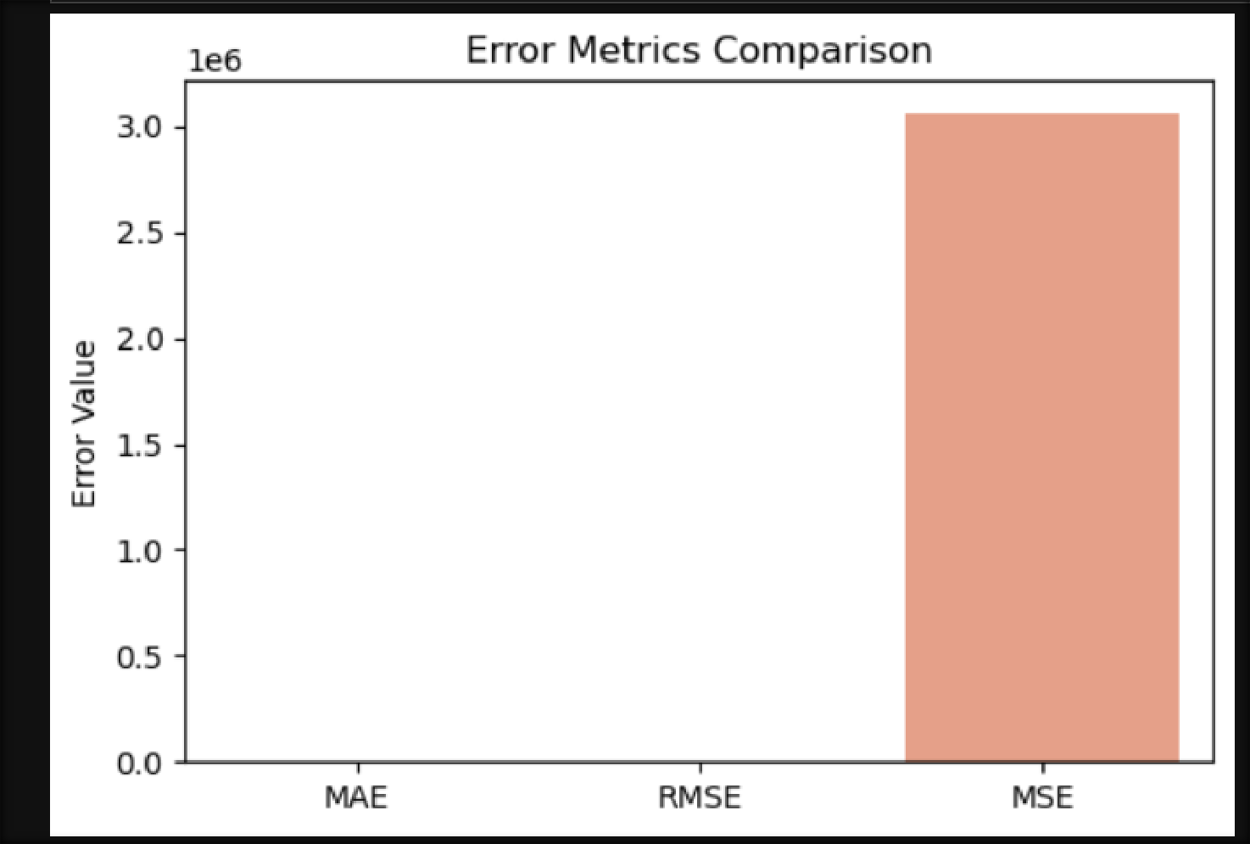
📸 SCREEN SHOT : 13 📸
✅Bar chart of error metrics✅

Slide 23
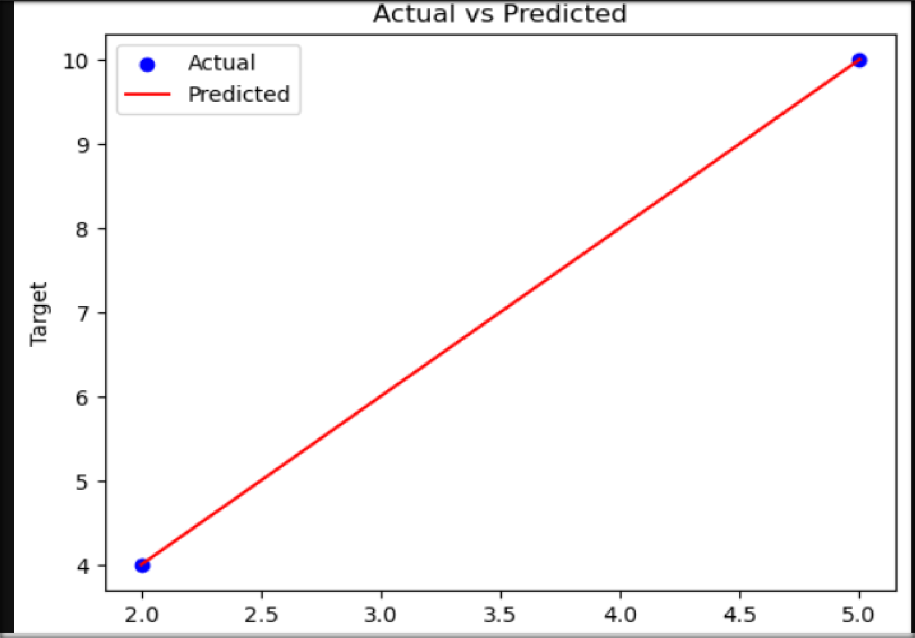
📸 SCREEN SHOT : 14 📸

Slide 24
🙏 Thank You
Your attention is appreciated 💡
🏢 Next Hikes IT Solutions 🏢

